Slide 1
The List ADT
Characteristics:
• A List L stores items of some type, called ListElementType.
Operations:
void L.insert(ListElementType elem)
Precondition: None.
Postcondition: L_{post} = L_{pre} with an instance of elem added to L_{post}.
26年 11月 8日
Copyright 1997, Oxford University Press. All rights reserved.

Slide 2
List ADT
bool L.first(ListElementType &elem)
Precondition: None
Postcondition: If the list is empty, none. Otherwise, the variable elem contains the first item in L; the “next” item to be returned is the second in L.
Return: true if and only if there is at least one element in L.
bool L.next(ListElementType &elem)
Precondition: The “first” operation has been called at least once.
Postcondition: Variable elem contains the next item in L, if there is one, and the next counter advances by one; if there is no next element, none.
Return: true if and only if there is a next item.
26年 11月 8日
Copyright 1997, Oxford University Press. All rights reserved.

Slide 3
Code Example 7-1
// cx7-1.h
// Code Example 7-1: List ADT header file
#include "dslib.h"
// the type of the individual elements in the list is defined here
typedef int ListElementType;
// implementation specific stuff here
class List {
public:
List();
void insert(const ListElementType & elem);
bool first(ListElementType & elem);
bool next(ListElementType & elem);
private:
// implementation specific stuff here
};
26年 11月 8日
Copyright 1997, Oxford University Press. All rights reserved.

Slide 4
Code Example 7-2
// cx7-2.h
// Code Example 7-2: header file for list implemented with an array
#include "dslib.h"
// the type of the individual elements in the list is defined here
typedef int ListElementType;
// the maximum size for lists is defined here
const int maxListSize = 1000;
26年 11月 8日
Copyright 1997, Oxford University Press. All rights reserved.

Slide 5
Code Example 7-2
class List {
public:
List();
void insert(const ListElementType & elem);
bool first(ListElementType & elem);
bool next(ListElementType & elem);
private:
ListElementType listArray[maxListSize];
int numberOfElements; // 지금 몇 개 가 채워져 있는가
int currentPosition; // first와 next가 실행시 몇번째 위치를 가리키는지 나타낸다.
};
26年 11月 8日
Copyright 1997, Oxford University Press. All rights reserved.

Slide 6
Code Example 7-3
// cx7-3.cpp
// Code Example 7-3: implementation file, list implemented with an array
#include "cx7-2.h"
// 생성자 변수 초기화
List::List()
{
// initialize to an empty list
numberOfElements = 0;
currentPosition = -1; // 주의! currentPosition을 -1로 유지한다.
// 그 이유는 한번도 first를 하지 않을 수도 있기 때문
}
26年 11月 8日
Copyright 1997, Oxford University Press. All rights reserved.

Slide 7
Code Example 7-3
void List::insert(const ListElementType & elem)
{
assert(numberOfElements < maxListSize);
listArray[numberOfElements] = elem; // 비어있는 첫번째 index
numberOfElements++;
}
bool List::first(ListElementType & elem)
{
if (numberOfElements == 0) // 데이터가 없을 경우
return false;
else {
currentPosition = 0;
elem = listArray[currentPosition];
return true;
}
}
26年 11月 8日
Copyright 1997, Oxford University Press. All rights reserved.

Slide 8
Code Example 7-3
bool List::next(ListElementType & elem)
{
// with proper use, currentPosition should always be
// greater than or equal to zero
assert(currentPosition >= 0); // 양의 정수가 나오면 first를 한번 했구나 생각 가능
if (currentPosition >= numberOfElements - 1) // 같다고 해도 된다
return false;
else {
currentPosition++;
elem = listArray[currentPosition];
return true;
}
}
26年 11月 8日
Copyright 1997, Oxford University Press. All rights reserved.

Slide 9
Code Example 7-4
// cx7-4.cpp
// Code Example 7-4: simple List client
#include "cx7-2.h" // header for Linear List; ListElementType is int
int main()
{
List l;
ListElementType i; // header file defines this to be int
cout << "Enter items to add to list, add 0 to stop: ";
cin >> i;
26年 11月 8日
Copyright 1997, Oxford University Press. All rights reserved.

Slide 10
Code Example 7-4
while (i != 0) {
l.insert(i);
cin >> i;
}
cout << "Here are the items in the list.\n";
ListElementType elem;
bool notEmpty(l.first(elem));
while (notEmpty) {
cout << elem << endl;
notEmpty = l.next(elem);
}
return 0;
}
26年 11月 8日
Copyright 1997, Oxford University Press. All rights reserved.

Slide 11
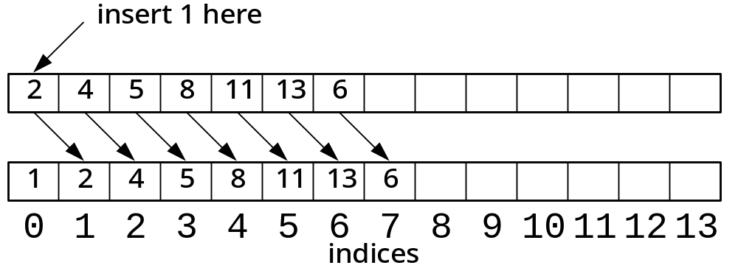
Figure 7-1
26年 11月 8日
Copyright 1997, Oxford University Press. All rights reserved.

Slide 12
실습예제
Array를 이용한 list를 구현하기 위해서 프로젝트를 생성한다.
main 함수 내용을 강의자료에서 복사하고, iostream 등을 포함
프로젝트->클래스 추가를 이용하여 List 클래스를 추가한다.
3쪽과 4쪽에 있는 정의부를 추가된 클래스에 복사해서 넣음
5쪽에서 7쪽까지 내용을 잘(!!) 복사해서 넣는다
Main 함수 파일에서 List 클래스를 include 한다
컴파일하면 에러가 나옴. Assert 를 사용하기 위해서는 #include <assert.h> 를 list.cpp에 포함
실행한다. 한개씩 입력하고 다 입력한후 0 을 넣으면 결과가 출력된다
List 클래스 사용법을 익히기 위해서 main 함수를 가지고 놀자
26年 11月 8日
Copyright 1997, Oxford University Press. All rights reserved.

Slide 13
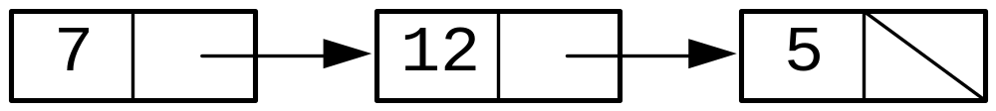
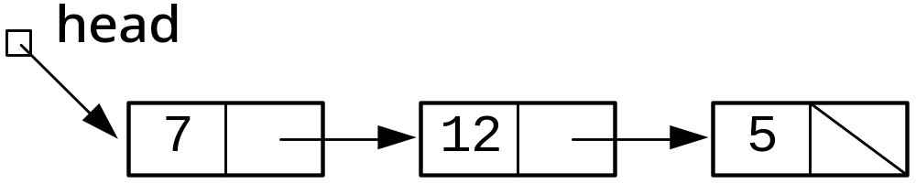
Implementation via Linked List
Figure 7-2 Abstract representation of a linked list
Fig 7-3 linked list with external link
26年 11月 8日
Copyright 1997, Oxford University Press. All rights reserved.

Slide 14
Adding a new node to header
1. Create a new node
2. Copy the data value into the new node
3. Copy the external link(head) into the link field of the new node
4. Change the external link(head) to point to the new node
26年 11月 8日
Copyright 1997, Oxford University Press. All rights reserved.

Slide 15
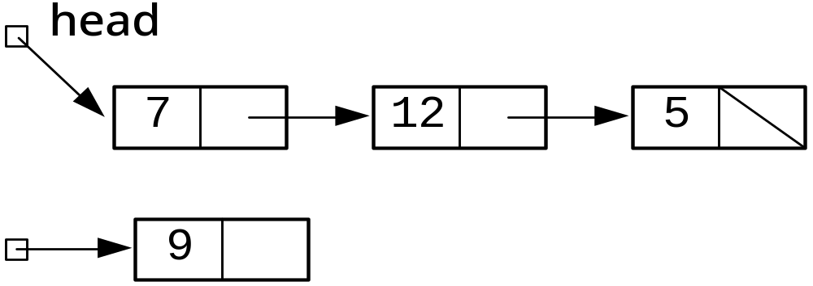
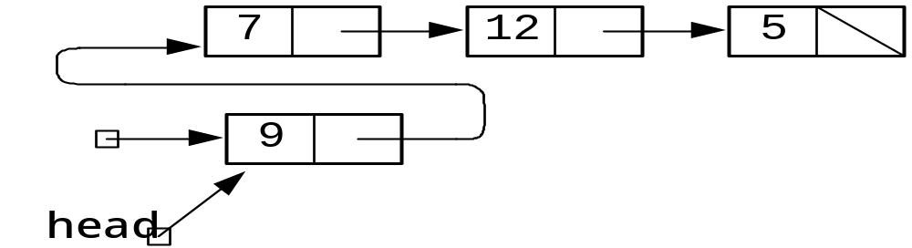
Pictorial description
26年 11月 8日
Copyright 1997, Oxford University Press. All rights reserved.

Slide 16
Adding an element to the end of a list
1. Create a new node
2. Copy the data value into the new node
3. Change the next field in the last node(i.e. the node pointed to by tail) to point the new node
4. Mark the next field in the new node to indicate that it is the end of the list
5. Move the tail pointer to the new node
26年 11月 8日
Copyright 1997, Oxford University Press. All rights reserved.

Slide 17
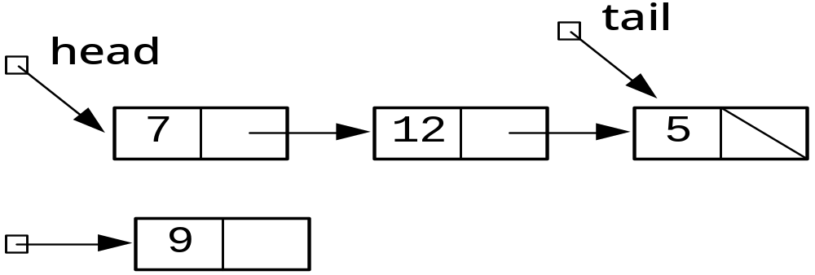
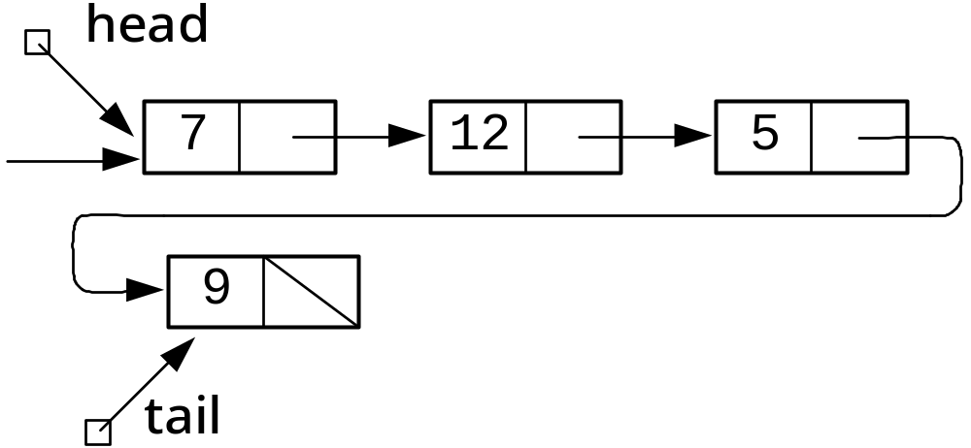
Pictorial description
26年 11月 8日
Copyright 1997, Oxford University Press. All rights reserved.

Slide 18

Algorithm 7-1: traversing a list
Comment: Assume that “head” is the name of the external link to the list.
current head;
while current is not NULL {
process the node that current points to;
current the link field of the node current points to;
}
26年 11月 8日
Copyright 1997, Oxford University Press. All rights reserved.

Slide 19
Code Example 7-5
// cx7-5.h
// Code Example 7-5: header file for list implemented with a linked list
#include "dslib.h"
// the type of the individual elements in the list is defined here
typedef int ListElementType;
class List {
// Use L to mean "this List"
public:
List();
26年 11月 8日
Copyright 1997, Oxford University Press. All rights reserved.

Slide 20
Code Example 7-5
// Precondition: None
// Postcondition: L is an empty List
void insert(const ListElementType & elem);
// Precondition: None
// Postcondition: Lpost = Lpre with an instance of elem added to Lpost
bool first(ListElementType & elem);
// Precondition: None
// Postcondition: If the list is empty, none. Otherwise, the variable
// elem contains the first item in L; the "next" item to be returned
// is the second in L.
// Returns: true if and only if there is at least one element in L.
26年 11月 8日
Copyright 1997, Oxford University Press. All rights reserved.

Slide 21
Code Example 7-5
bool next(ListElementType & elem);
// Precondition: The "first" operation has been called at least once.
// Postcondition: Variable elem contains the next item in L, if there is one,
// and the next counter advances by one; if there is no next element, none.
// Returns: true if and only if there was a next item.
private:
struct Node; // declaration without definition
typedef Node *Link; // use declaration of Node
struct Node { // now we define Node
ListElementType elem;
Link next;
};
Link head;
Link tail;
Link current;
};
26年 11月 8日
Copyright 1997, Oxford University Press. All rights reserved.

Slide 22
Code Example 7-8
// cx7-8.cpp
// Code Example 7-8: implementation file, linked list implementation of List ADT
#include "cx7-5.h"
List::List()
{
// Initialize an empty List
head = 0;
tail = 0;
current = 0;
}
26年 11月 8日
Copyright 1997, Oxford University Press. All rights reserved.

Slide 23
Code Example 7-8
void List::insert(const ListElementType & elem)
{
Link addedNode = new Node;
assert(addedNode); // check to make sure node was allocated
addedNode->elem = elem;
if (head == 0) // list was empty -- set head
head = addedNode;
else
tail->next = addedNode;
tail = addedNode;
addedNode->next = 0;
}
26年 11月 8日
Copyright 1997, Oxford University Press. All rights reserved.

Slide 24
Code Example 7-8
bool List::first(ListElementType & elem)
{
// After calling first, current points to first item in list
if (head == 0)
return false;
else {
elem = head->elem;
current = head;
return true;
}
}
26年 11月 8日
Copyright 1997, Oxford University Press. All rights reserved.

Slide 25
Code Example 7-8
bool List::next(ListElementType & elem)
{
// with proper use, current should always be nonzero
assert(current);
// After each call, current always points to the item
// that next has just returned.
if (current->next == 0)
return false;
else {
current = current->next;
elem = current->elem;
return true;
}
}
26年 11月 8日
Copyright 1997, Oxford University Press. All rights reserved.

Slide 26
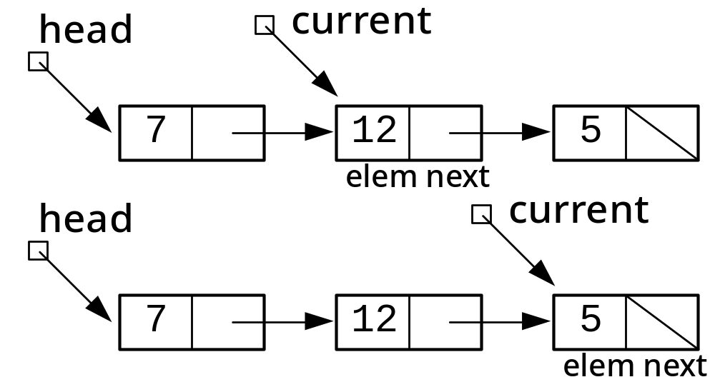
Figure 7-8
26年 11月 8日
Copyright 1997, Oxford University Press. All rights reserved.

Slide 27
실습예제
새로운 프로젝트 LinkedList를 생성한다
바로 앞에 사용했던 main 함수 내용을 그대로 가져온다. (자료구조가 바뀌는것 뿐이다. 사용자에게는 동일한 사용법이다)
프로젝트->클래스 추가에서 List 클래스를 추가한다.
  18-20 을 사용하여 header 파일 완성
  21-24 를 사용하여 cpp 파일 완성
실행해본다
소멸자를 만들어본다.
  Node를 만들었다면 공간을 할당했을 것이므로 이 공간들을 풀어준다
  공간 할당 한것을 head !=0 으로 검사할수 있다
while(head !=0){Link delNode = head;
head = head->next;
delete delNode; }
26年 11月 8日
Copyright 1997, Oxford University Press. All rights reserved.
Notes:
소멸자 코드는 외우기!
Figures from "Data Structures via C++: Objects by Evolution"
26年 11月 8日
Copyright 1997, Oxford University Press. All rights reserved.

Slide 28
실습예제
Insert 를 살펴보면 node 공간 할당하고, 데이터를 넣고, 맨 처음 넣는 경우를 특별하게 처리하고 그렇지 않다면 tail에 새로운 node를 추가하고, tail pointer를 갱신하고. 새로운 node->next=0 로 만듦을 알 수 있다. 이 프로그램과 15쪽 개념적인 것과 어떤 차이점이 있는지 살펴보자
구현된 Insert를 tail에 추가하는 insert 인데 이제 head 에 추가하는 insert를 구현해보자. 이전 것을 comment처리하고, 다시 복사해서 이를 근거로 시작한다.
  Node 공간 할당하고, 데이터를 넣고, 맨처음 데이터를 넣는 경우는 특별하게 처리한다.( addedNode 가 처음 들어가므로 addedNode->next = NULL이 되어야 함. 그리고 tail 이 처음 노드를 가르키게 한다.). 그런 경우가 아니면 새 node->next = head 를 가르키게 하고. 끝으로 head = addedNode가 되게 한다.
실행해 본다.
26年 11月 8日
Copyright 1997, Oxford University Press. All rights reserved.

Slide 29
ADT 7-2(Inorder List ADT)
Characteristics:
• An Inorder List L stores items of some type (ListElementType) that is totally ordered.
• The items in the List are in order; that is, if a and b are elements of ListElement Type, and a < b, then if a and b are in L, a will be before b.
Prerequisite:
ListElementType must work with the operations <= and ==.
Operations:
void L.insert(const ListElementType &elem)
Precondition: None.
Postcondition: L = L with an instance of elem added to the list
26年 11月 8日
Copyright 1997, Oxford University Press. All rights reserved.

Slide 30
ADT 7-2
bool L.first(ListElementType &elem)
Precondition: None
Postcondition: If the list is empty, none. Otherwise, the variable elem contains the smallest item in L; the “next” item to be returned is the second in L.
Return: true if and only if there is at least one element in L.
bool L.next(ListElementType &elem)
Precondition: The “first” operation has been called at least once.
Postcondition: Variable elem contains the next item in L, in order, if there is one.
Return: true if and only if there is a next item.
26年 11月 8日
Copyright 1997, Oxford University Press. All rights reserved.

Slide 31
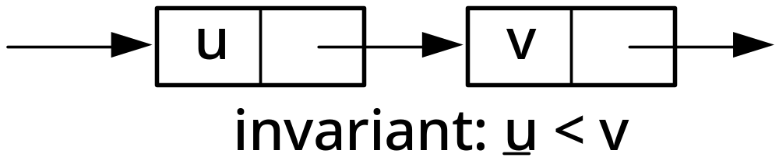
Figure 7-9
26年 11月 8日
Copyright 1997, Oxford University Press. All rights reserved.

Slide 32
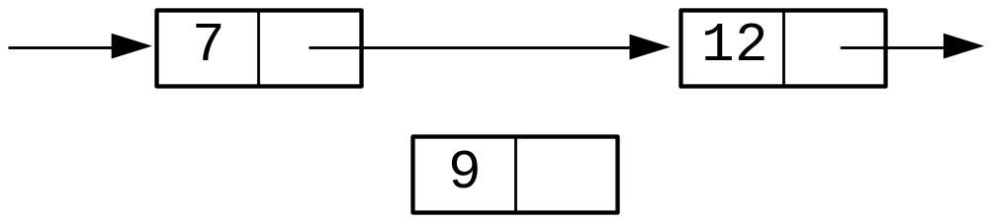
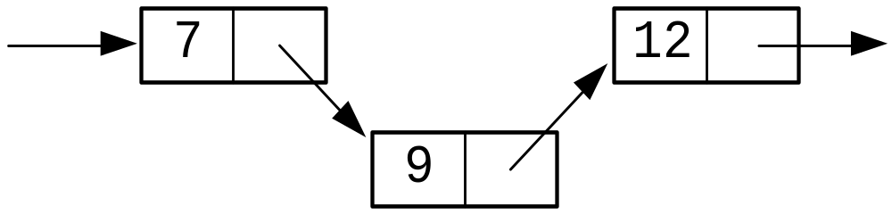
Insertion of Inorder list
26年 11月 8日
Copyright 1997, Oxford University Press. All rights reserved.

Slide 33
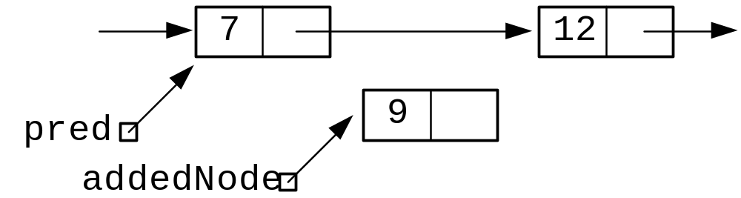
Figure 7-12(pointers prepared for insertion)
26年 11月 8日
Copyright 1997, Oxford University Press. All rights reserved.

Slide 34
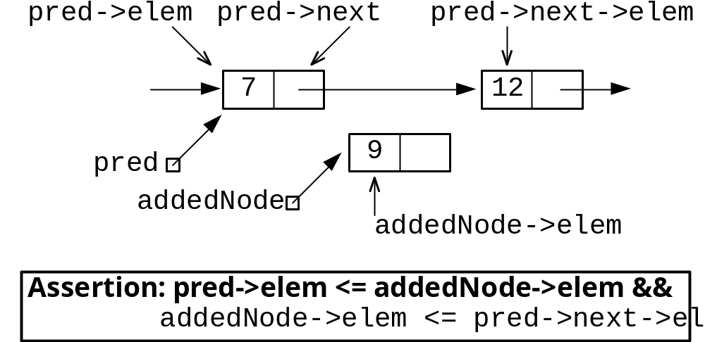
Figure 7-13
26年 11月 8日
Copyright 1997, Oxford University Press. All rights reserved.

Slide 35

Assertion 7-1
(pred elem <= addedNode elem) &&
(addedNode elem <= pred next elem || pred next == 0).
26年 11月 8日
Copyright 1997, Oxford University Press. All rights reserved.

Slide 36
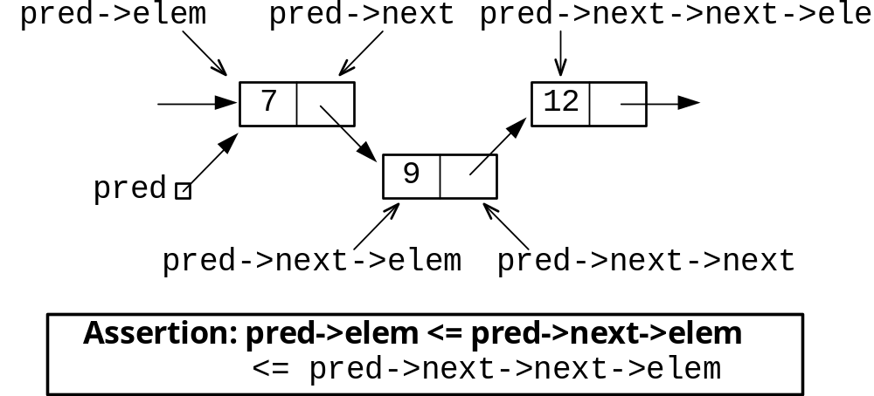
Figure 7-14
26年 11月 8日
Copyright 1997, Oxford University Press. All rights reserved.

Slide 37
Assertions
7-2 addedNode elem > pred next elem
7-3 pred next != 0
26年 11月 8日
Copyright 1997, Oxford University Press. All rights reserved.

Slide 38
Code Example 7-9
// cx7-9.cpp
// Code Example 7-9: insert function for an Inorder List ADT
// cx7-8.cpp
// Code Example 7-8: implementation file, linked list implementation of List ADT
#include "cx7-5.h"
void List::insert(const ListElementType & elem)
{
// precondition: list is in order
Link addedNode(new Node);
26年 11月 8日
Copyright 1997, Oxford University Press. All rights reserved.

Slide 39
Code Example 7-9
assert(addedNode);
addedNode->elem = elem;
// Special case: if the existing list is empty, or if the new data
// is less than the smallest item in the list, the new node is added
// to the front of the list
if (head == 0 || elem <= head->elem) {
addedNode->next = head;
head = addedNode;
}
else {
// find the pointer to the node that is the predecessor
// to the new node in the in-order list
26年 11月 8日
Copyright 1997, Oxford University Press. All rights reserved.

Slide 40
Code Example 7-9
Link pred(head);
// assertion: pred->elem <= addedNode->elem
while (pred->next != 0 && pred->next->elem <= addedNode->elem)
// loop invariant: pred->next != 0 && pred->next->elem <= elem
pred = pred->next;
// assertion 7-1: (pred->elem <= addedNode->elem) &&
// (addedNode->elem <= pred->next->elem || pred->next == 0)
addedNode->next = pred->next;
pred->next = addedNode;
// assertion: pred->elem <= pred->next->elem &&
// (pred->next->elem <= pred->next->next->elem || pred->next->next == 0)
}
// postcondition: list is in order, with elem added in proper position
}
26年 11月 8日
Copyright 1997, Oxford University Press. All rights reserved.

Slide 41
실습예제
Linked List 에서 Inorder List를 구현하기 위해서 insert 만을 37-39 로 변경한다.
실행해본다.
F5 로 디버그 모드로 가고, insert 함수안에서 break point를 찍어서 tracing 해본다
최초 노드를 넣을때와 가장 앞에 노드가 올때는 특별히 다루고, 나머지의 경우에는 사이에 끼어 넣는 코드이다. Pred 의 값을 잘 따라가면서 보도록 하자. 그리고 pred->next->elem 등에서 pred->next 가 가르키는 주소 값등을 살펴봄으로써 참조위치를 명확히 이해하자.
26年 11月 8日
Copyright 1997, Oxford University Press. All rights reserved.

Slide 42
Code Example 7-10
// cx7-10.h
// Code Example 7-10: header file for list implemented with dummy head node
#include "dslib.h"
// the type of the individual elements in the list is defined here
typedef int ListElementType;
class List {
// Use L to mean "this List"
public:
List();
26年 11月 8日
Copyright 1997, Oxford University Press. All rights reserved.

Slide 43
Dummy head nodes
Eliminates special cases
Never insert/delete the first node
26年 11月 8日
Copyright 1997, Oxford University Press. All rights reserved.

Slide 44
Code Example 7-10
// Precondition: None
// Postcondition: L is an empty List
void insert(const ListElementType & elem);
// Precondition: None
// Postcondition: Lpost = Lpre with an instance of elem added to Lpost
bool first(ListElementType & elem);
// Precondition: None
// Postcondition: If the list is empty, none. Otherwise, the variable
// elem contains the first item in L; the "next" item to be returned
// is the second in L.
// Returns: true if and only if there is at least one element in L.
26年 11月 8日
Copyright 1997, Oxford University Press. All rights reserved.

Slide 45
Code Example 7-10
bool next(ListElementType & elem);
// Precondition: The "first" operation has been called at least once.
// Postcondition: Variable elem contains the next item in L, if there is one,
// and the next counter advances by one; if there is no next element, none.
// Returns: true if and only if there was a next item.
void remove(const ListElementType & target);
// Precondition: None
// Postcondition: Lpost = Lpre with one instance of target removed
26年 11月 8日
Copyright 1997, Oxford University Press. All rights reserved.

Slide 46
Code Example 7-10
private:
struct Node; // declaration without definition
typedef Node *Link; // use declaration of Node
struct Node { // now we define Node
ListElementType elem;
Link next;
};
Link head;
Link current;
};
26年 11月 8日
Copyright 1997, Oxford University Press. All rights reserved.

Slide 47
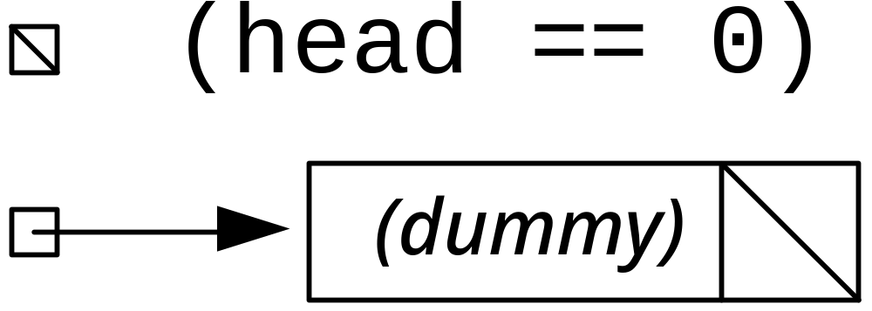
Figure 7-15(standard vs. dummy)
26年 11月 8日
Copyright 1997, Oxford University Press. All rights reserved.

Slide 48
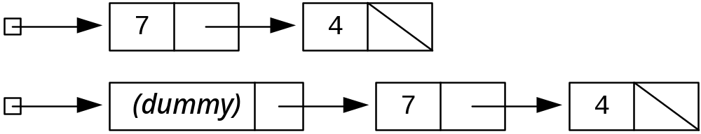
Figure 7-16(Standard vs. Dummy head)
26年 11月 8日
Copyright 1997, Oxford University Press. All rights reserved.

Slide 49
Code Example 7-11
// cx7-11.cpp
// Code Example 7-11: Inorder List implemented with dummy head node
#include "cx7-10.h"
List::List()
{
// Initialize an empty list
head = new Node;
assert(head);
head->next = 0;
current = 0;
}
26年 11月 8日
Copyright 1997, Oxford University Press. All rights reserved.

Slide 50
Code Example 7-11
void List::insert(const ListElementType & elem)
{
// precondition: list is in order
Link addedNode(new Node);
assert(addedNode);
addedNode->elem = elem;
// find the pointer to the node that is the predecessor
// to the new node in the in-order list
Link pred(head);
// loop invariant: pred>elem <= elem
while (pred->next != 0 && (pred->next->elem <= addedNode->elem))
pred = pred->next;
26年 11月 8日
Copyright 1997, Oxford University Press. All rights reserved.

Slide 51
Code Example 7-11
// assertion 7-1: (pred>elem <= addedNode>elem) &&
// (addedNode->elem <= pred->next->elem || pred->next == 0)
addedNode->next = pred->next;
pred->next = addedNode;
// postcondition: list is in order
}
bool List::first(ListElementType &elem)
{
// After calling first, current points to first item in list
assert(head); // if no head, something is very wrong!
26年 11月 8日
Copyright 1997, Oxford University Press. All rights reserved.

Slide 52
Code Example 7-11
if (head->next == 0)
return false;
else {
current = head->next;
elem = current->elem;
return true;
}
}
bool List::next(ListElementType & elem)
{
// With proper use, current should always be nonzero
assert(current);
26年 11月 8日
Copyright 1997, Oxford University Press. All rights reserved.

Slide 53
Code Example 7-11
// After each call, current always points to the item
// that next has just returned.
if (current->next == 0)
return false; // no next element available
else {
current = current->next;
elem = current->elem;
return true;
}
}
26年 11月 8日
Copyright 1997, Oxford University Press. All rights reserved.

Slide 54
Code Example 7-11
void List::remove(const ListElementType & target)
{
assert(head);
Link pred, delNode;
// pred starts out pointing at the dummy head
for (pred = head; pred->next != 0 && pred->next->elem < target;pred = pred->next);
// at this point, check to see if we've found target --
// if so, remove it
// Have to check carefully to make sure we don't
// dereference a null pointer!
if (pred && (pred->next) && (pred->next->elem == target)) {
// remove the next node in the list
delNode = pred->next;
pred->next = delNode->next;
delete delNode; // return node to memory
}
}
26年 11月 8日
Copyright 1997, Oxford University Press. All rights reserved.

Slide 55
실습예제
Dummy head 프로젝트를 생성한다.
Main 함수는 이전 linked list를 그대로 가져온다.
프로젝트->클래스추가 로 List 클래스를 추가하고, 내용은 41-53까지를 *.h와 *.cpp 파일에 알맞게 넣는다.
역시 Inorder List 임을 잊지 말고, 맨 앞에 들어가는 특별한 경우가 제외 됨을 상기하자.
각 함수들을 이전의 Inorder 함수와 비교해 보자
26年 11月 8日
Copyright 1997, Oxford University Press. All rights reserved.

Slide 56
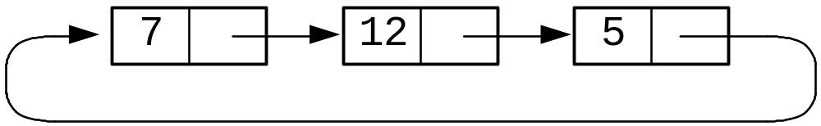
Circular linked list
Need external pointer for tail(why?)
26年 11月 8日
Copyright 1997, Oxford University Press. All rights reserved.

Slide 57
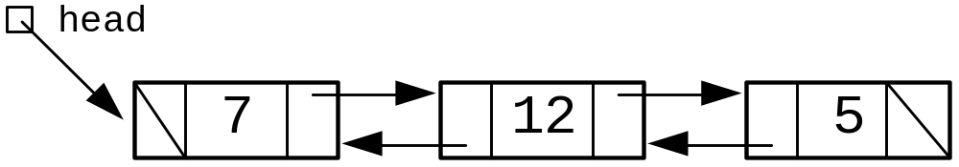
Doubly linked list
26年 11月 8日
Copyright 1997, Oxford University Press. All rights reserved.

Slide 58
Code Example 7-12
// cx7-12.h
// Code Example 7-12: header file for doubly-linked list
#include "dslib.h"
// the type of the individual elements in the list is defined here
typedef int ListElementType;
class List {
public:
List();
void insert(const ListElementType & elem);
26年 11月 8日
Copyright 1997, Oxford University Press. All rights reserved.

Slide 59
Code Example 7-12
bool first(ListElementType & elem);
bool next(ListElementType & elem);
bool previous(ListElementType & elem);
private:
struct Node; // declaration without definition
typedef Node *Link;
struct Node {
ListElementType elem;
Link next;
Link prev;
};
Link head;
Link current;
};
26年 11月 8日
Copyright 1997, Oxford University Press. All rights reserved.

Slide 60
Code Example 7-13
// cx7-13.cpp
// Code Example 7-13: insertion into a doubly-linked list
#include "cx7-12.h"
void List::insert(const ListElementType & elem)
{
Link addedNode = new Node;
assert(addedNode);
addedNode->elem = elem;
addedNode->next = head;
if (head) // test to see if there was a node in the list
head->prev = addedNode; // if so, it needs to point back to the new node
addedNode->prev = 0;
head = addedNode;
}
26年 11月 8日
Copyright 1997, Oxford University Press. All rights reserved.

Slide 61
Code Example 7-14
// cx7-7.cpp
// Code Example 7-7: implementation file, linked list implementation of List ADT
#include "cx7-12.h"
// cx7-14.cpp
// Code Example 7-14: previous function for a doubly-linked list
bool List::previous(ListElementType &elem)
{
assert(current);
26年 11月 8日
Copyright 1997, Oxford University Press. All rights reserved.

Slide 62
Code Example 7-14
if (current->prev == 0)
return false;
else {
current = current->prev;
elem = current->elem;
return true;
}
}
26年 11月 8日
Copyright 1997, Oxford University Press. All rights reserved.

Slide 63
실습예제
Doubly linked list를 프로젝트로 만든다
Main 함수는 이전 linked list를 그대로 가져온다.
프로젝트->클래스추가 로 List 클래스를 추가하고, 내용은 57-61까지를 *.h와 *.cpp 파일에 알맞게 넣는다.
First 와 next 는 이전의 InorderList 것이나 그 전 것을 가져온다. 왜냐하면 이것은 dummy head를 사용하지 않았기 때문이다. 생성자에서는 head와 current를 NULL로 초기화한다.
Main 함수에서 next와 prev를 사용하여 traverse 한다
26年 11月 8日
Copyright 1997, Oxford University Press. All rights reserved.

Slide 64
Dynamic linear list
Allocate memory while running
26年 11月 8日
Copyright 1997, Oxford University Press. All rights reserved.

Slide 65
Code Example 7-15
// cx7-15.h
// Code Example 7-15: header file for dynamic list
#include "dslib.h"
// the type of the individual elements in the list is defined here
typedef int ListElementType;
class List {
public:
List(int lSize);
void insert(const ListElementType & elem);
26年 11月 8日
Copyright 1997, Oxford University Press. All rights reserved.

Slide 66
Code Example 7-15
bool first(ListElementType & elem);
bool next(ListElementType & elem);
int size();
private:
ListElementType * listArray;
int numberOfElements;
int currentPosition;
int listSize;
};
26年 11月 8日
Copyright 1997, Oxford University Press. All rights reserved.

Slide 67
Code Example 7-16
// cx7-16.cpp
// Code Example 7-16: partial implementation of dynamic list
#include "cx7-15.h"
List::List(int lSize)
{
assert(lSize > 0);
listSize = lSize;
listArray = new ListElementType[listSize];
assert(listArray); // make sure memory was successfully allocated
numberOfElements = 0;
currentPosition = -1;
}
int List::size()
{
return listSize;
}
26年 11月 8日
Copyright 1997, Oxford University Press. All rights reserved.

Slide 68
Code Example 7-17
// cx7-17.cpp
// Code Example 7-17: (partial) client for the dynamic list
#include "cx7-15.h"
int main()
{
int list1size, list2size;
cout << "Enter size of the first list: ";
cin >> list1size;
List list1(list1size);
cout << "Enter size of the second list: ";
cin >> list2size;
List list2(list2size);
// . . . and so on . . .
}
26年 11月 8日
Copyright 1997, Oxford University Press. All rights reserved.

